Slide 1


Slide 2

#LifeKoKaroLift
SGC Coaching:
Session 10
Profile Building

Slide 3
Agenda: Enhance Your Profile
Focussed teaching–(20 mins)
Attract the target recruiters with effective resume
Personalised Feedback–(70 mins)
Create effective resume/ profile & improve targeting
Provide personalized feedback

Slide 4
Own your Career| Pick What is Best For You
Your career choices are influenced by:
Who are you as a person (personality, values, interests, natural strength)?
Career life-stage led key aspirations and growth opportunities.
What experiential learning you gathered beyond tools & techniques
Pick Your next option through:
Creating your own brand with right messaging.
Highlighting relevant achievements/accolades
Build your own network
Notes:
Start with theme of how to show accountability and take initiatives and accepting your mistakes to take corrective actions

Slide 5




Steer your career through effective development plan
Strength/ Boosters
Build development plan
Build your credentials
Highlight boosters
Barriers/ challenges
Your Career aspiration
Notes:
Everybody needs to stay on track and effective development plan is the right way forward.
This slide is meant to persuade the learners to think about their achievements/ profile deeply.

Slide 6

Enhance Your Resume Building Skills: Build your Brand Purposefully.
How To Build Impressive Resume/LinkedIn Profile
Executive summary highlighting critical skills and strategic function within the organization, to showcase value additions.
What should it contain? Ask yourself these questions:
If I could tell a hiring panel just three things about myself, what would they be?
What career achievements am I most proud of?
What are my areas of expertise?
What are my most valuable intangible traits (e.g. pragmatic, relentless, entrepreneurial)?
What would I like to achieve next?
What unique skills, traits, or experiences do I bring to the table?
Notes:
Discuss examples of profiles to illustrate these areas better.

Slide 7

Structure of Profile
Opening Title: Current Role, highlighting what is your critical function in the organization.
Executive Summary: Keep it crisp and engaging for the recruiters to run through your entire profile.
Body
Work experience: Most recent experience at the top.
Highlight key projects and achievements in each of your experience to draw attention.
State the tangible facts to substantiate your claims.
Publications: Share links of your published whitepapers, journals, blogs
Education/ Certification: Start from most recent education
Add it before work- experience only if it adds significant relevance to your profile
Adding details on capstone/internship project is useful.
Language skills could be a good value-add.
Personal Details: Include the relevant details only including your topic of interests

Slide 8

Examples to show your tangible achievements.
Show your achievements tangibly.
“Grew net revenue by 23% in just six months.”
“Reduced IT infrastructure overhead by 40% by transitioning from company-leased data centers to a public cloud.”
“Restructured customer success function, resulting in 30% increase in revenue and 74% decrease in client attrition.”
“Designed and implemented new data processing program for 200-member marketing division at XYZ Corp. that saved more than $2 million in consulting fees over a 5-year period.”
Notes:
Discuss examples of profiles to illustrate these areas better.

Slide 9
What do the Recruiters Look For while Shortlisting?
Survey findings
40% : Focusing on skills relevant to the job offered
36% : Highlighting universally desired skills such as analytical skills, teamwork and
leadership help a resume stand out.
35% : recruiters advise including skills that add value to the position applied for.
26% : Researching profiles of professionals working in the same job applied provides better idea.
21% : Adding statistics and numbers to skills to substantiate them and show measurable results
20%: of recruiters give more weightage to adaptability.
Notes:
The numbers don’t add up since these are based on survey inputs of 690 recruiters/ hiring managers.

Slide 10
Significance of Project Highlights
Types of Projects to Showcase
Leadership and Executive Presence
Technical skills and Research Mindset
Job Competency
How These Help In Improving Your Job Hit Rate?
It demonstrates leadership skills and initiative.
It demonstrates a proven track record of success.
It allows potential employers to mentally insert you into a position that requires a similar skill set.
Increase Precision To Highlight Potential
Add measurable parameters to substantiate the success in projects.
Do not exceed your description beyond 2-3 lines.
Varied Experiences: A double edged sword hence leverage to show career progression carefully, e.g. Delivery Leader to Individual technical roles
Notes:
Discuss the varied experience role properly. If not showcased properly, it may show lack of focus or unstable job switcher.
More than certifications, job role with specific skillsets attract better due to proven application experience.

Slide 11
Real Examples of Profile/ Resume
Professional Summary- Example
12+ years of experience in Pricing and Marketing Analytics, spanning across roles including business consulting, as subject matter expert, as project and people manager. Skilled in delivering statistical analysis and providing business insights to global CPG clients.
Experience Summary- Example
Trade Specialist
Company Name
Dates Employed
Employment Duration
Location
Plan in conjunction with Head of Trade Marketing, Sales Team the merchandising , distribution and pricing strategy for the Fiscal. Pre & post promotion deep dives through ROI calculations , Consumer behaviour & other data readings when applicable. Consult with other functions internally and externally as necessary to gain information & insights about the competition and making recommendations basis thorough evaluations
Senior Consultant Knowledge Centre, Thought Leadership
Company Name…
Responsible for qualitative and quantitative research activities in support of the Thought Leadership business area. Research focuses on the development of new insights, products and solutions in the "positive impact space," - ‘the intentional linking of social and economic opportunities to deliver greater value. Also involved in ongoing research to identify the drivers of best practice Balanced Scorecard implementations and to further evolve the concept and methodology. A further key focus area is providing analytical support to XYZ’s global marketing efforts - focused on the use of digital vehicle

Slide 12
Resources
Create your resume using the layouts from:
https://www.canva.com/create/resumes/
Graphicriver.net: elegant-resume

Slide 13

Network worth.

Slide 14

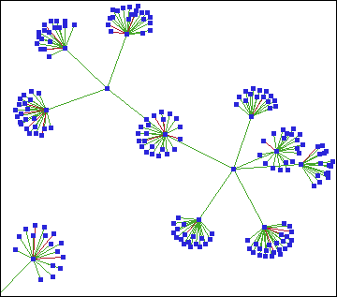
Power of Targeted Networking
LinkedIn: Most recommended professional Network
Spend time judiciously and smartly on LinkedIn, and it has high potential to make you land at your preferred job or role.
Curate each item and your network to build your credentials in chosen field.
Power of Targeted Networking
Connect with industry SMEs/ domain experts to increase your weightage of influence in network.
Review your network to ensure that it is gravitating towards the relevant industry professionals and not randomly distributed including all contacts.
Connect to the professional communities with common interest areas, e.g. Machine Learning and Data Science to build professional presence.
Notes:
Here, the alert is to keep your network more focused towards your brand.

Slide 15
Endorsements / Recommendation
Value of endorsements
It may not establish your skills fully well, but a curated set of endorsements on top of profile will help the recruiters reach out to you easily.
Irrelevant endorsements must be removed from the list.
A lack of endorsements might make viewers skeptical about your social media presence as well as any skill sets you claim on your profile
Combined with recommendations, a large amount of endorsements will help you establish your reputation as an industry SME.
How to enhance the relevance of endorsements
Reorder top skills as your preferred ones and remove the ones which distract the viewer
Personalized Emails to your network so as to build your endorsement for preferred skills.
Recommendations
Detailed recommendations from your co-workers/ seniors speak volumes of your skillsets and perceived value in your organizations.
Send personalized message to your network to request for a recommendation which enhances your profile and emphasis on your professional relationship with the person.
Return the favour by writing a recommendation about them, especially in case of peers

Slide 16
Leverage LinkedIn to Boost Your Brand
Create a comprehensive profile which suits your growth need as well.
Highlight your interest in chosen field beyond your current role as needed.
Expand Your Network
Add people from chosen domain to your network
Increase your coverage through right engagement.
External Validation
Endorse people for their skills that you know.
Request known connections to write recommendations
Keep nurturing your network ongoing. Stay relevant.
Show Expertise/ Enthusiasm
Create your own contents and publish, write blogs
Participate in conversations focused to your domain
Things to remember:
Your profile needs to stay updated and reviewed periodically to keep abreast of changes.
Your network must include the right set of people to attract attention where needed.
Exhibit your executive presence in all your feeds/ responses to empower your brand image.
Job search on periodic basis helps you stay informed of the in-demand skills.
Notes:
Advice to learners:
From networking perspective, participation in forums has to be a critical element hence refrain from controversial/ inconsequential discussions

Slide 17
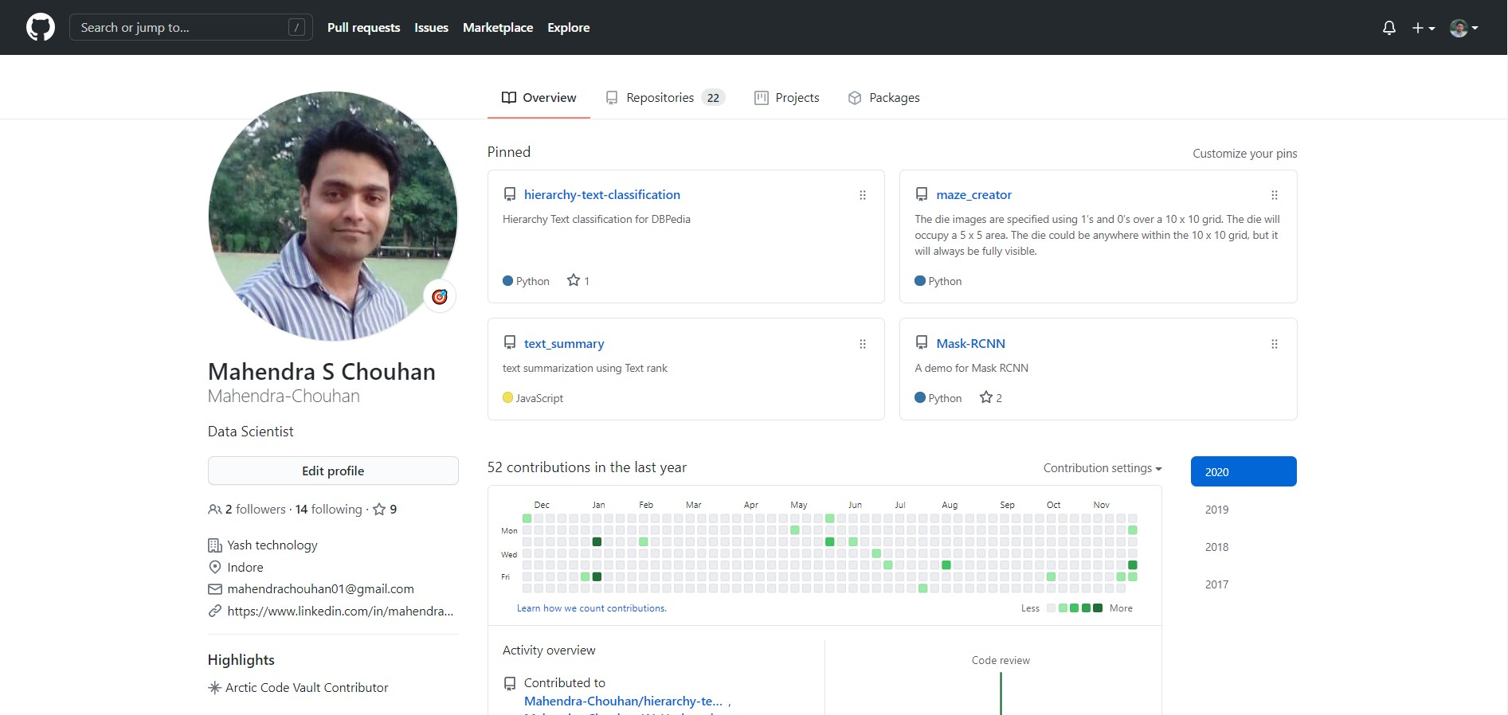
Github: New Resume

Slide 18
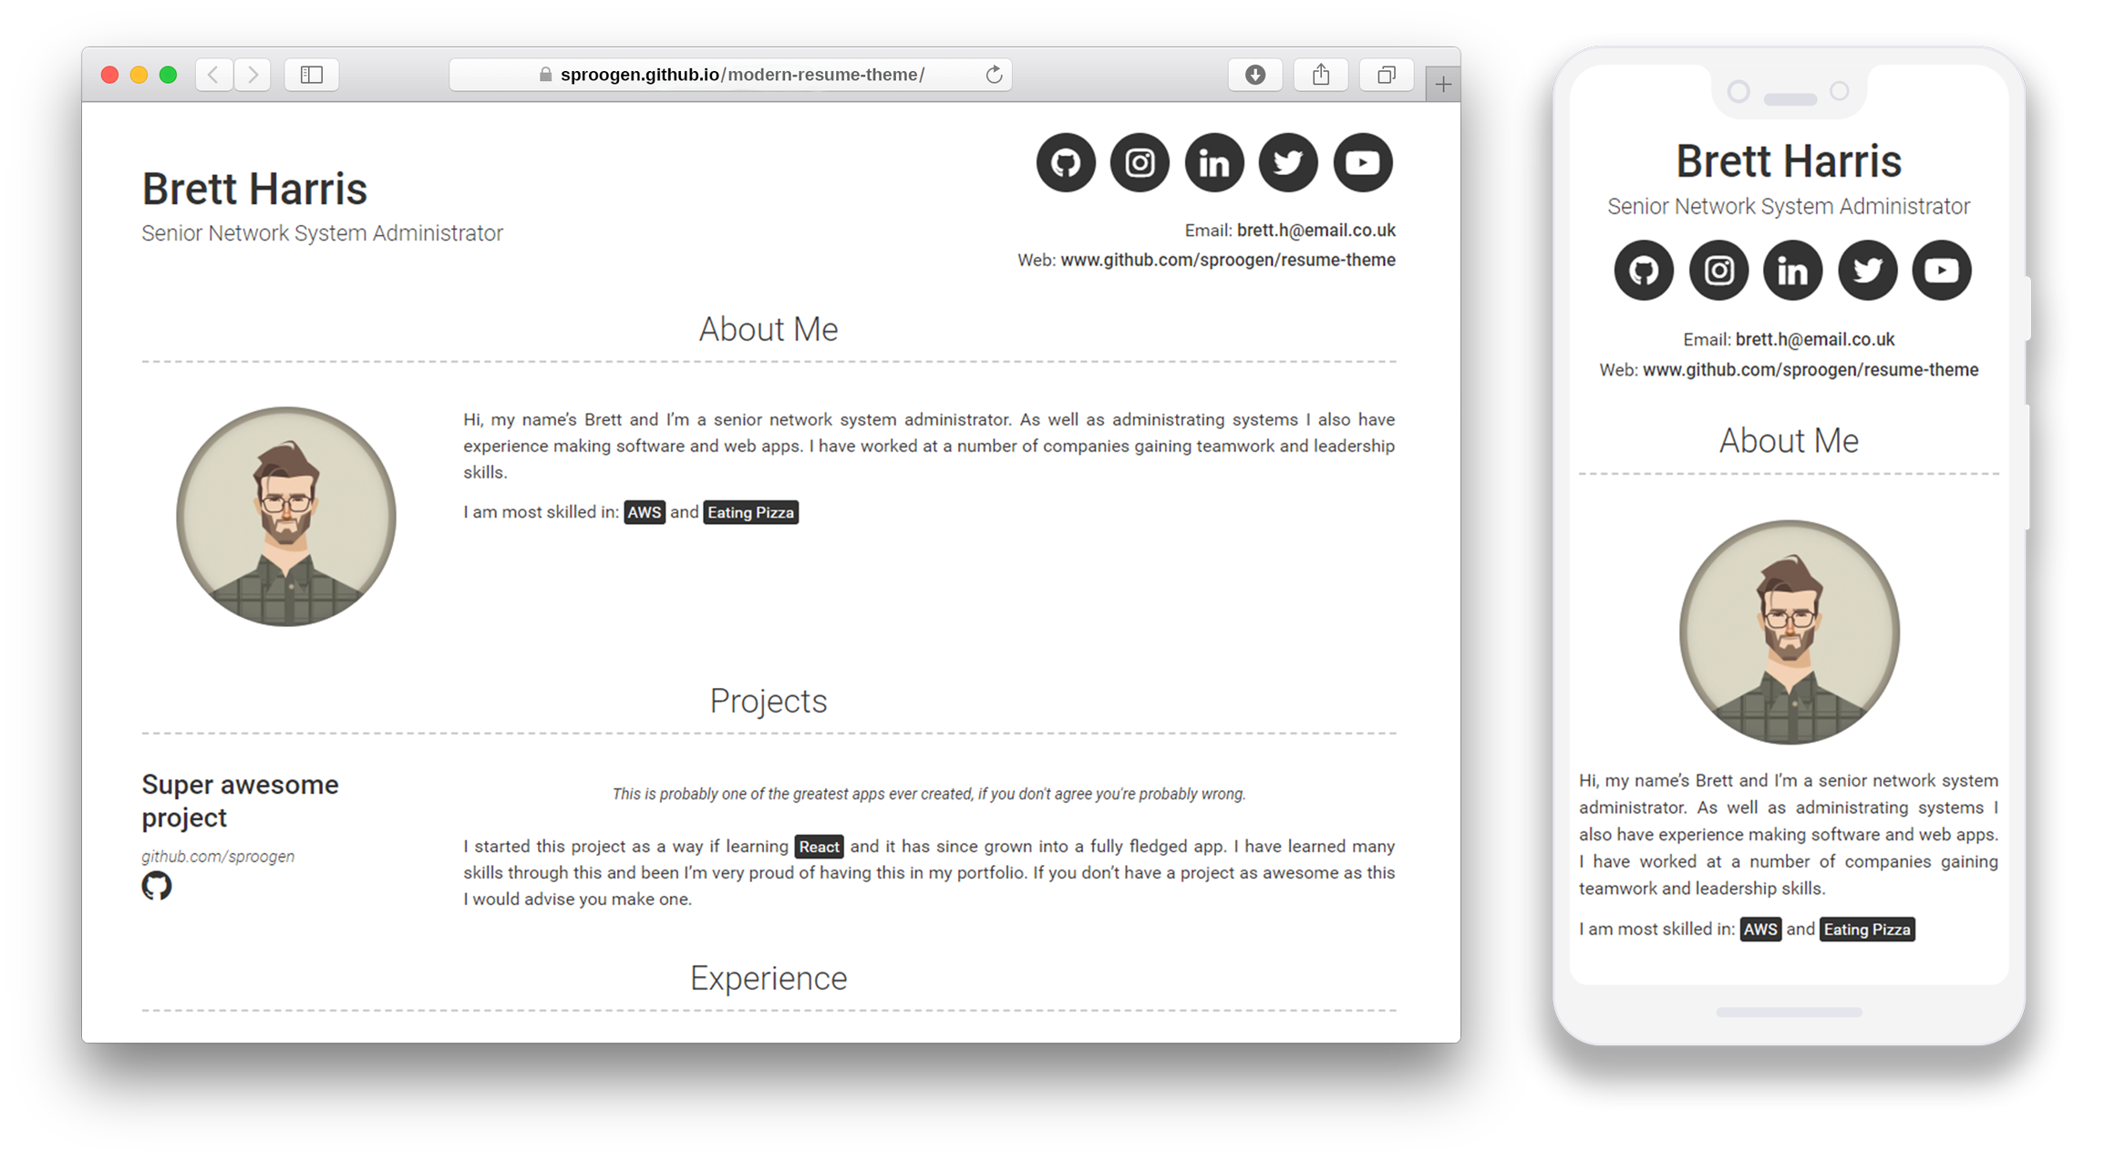
Github Page

Slide 19

Peer to Peer Reviews
Activity:
Group of 2
Share your LinkedIn Profiles & Resumes
What is their impression about you? Ask them to share candidly.
Individual feedback
How to club similar projects to strengthen the experience.
Adding more of different project examples will showcase the variety of problems and solutions.
Crispness of Resume (How to compress to 1 page) and highlight relevant skills.
Notes:
Examples:
Let the group share their comments with you as a post exercise and keep building on their resume and profile incorporating each other’s inputs
This will also serve as an input to the last resume building session.
How to carve opportunity in the chosen track? (In case of acceleration)

Slide 20
Followup Session- Resume/ LinkedIn
Resume/ LinkedIn Feedback
Continue with the resume reviews
Review the updated profiles/ resumes with stringent feedback on tangible highlights and linkage with business outcomes
Assert the importance of professional summary
Skill endorsements
Words like Solid background, Champion without providing tangible examples would not help.
Discuss peer feedback to keep the communication open and learn from each other.
How it is going to enable them keep track of their progress and achieve aspirations.

Slide 21

Question
What happened After model Deployment.

Slide 22
Problems
Unseen data
Changes in the environment and relationships between variables
Upstream data changes

Slide 23
Solutions
Regular Monitoring
Retraining
Manually vs Automatic
Business Vs ML goals

Slide 24



Tools

